Slide 1

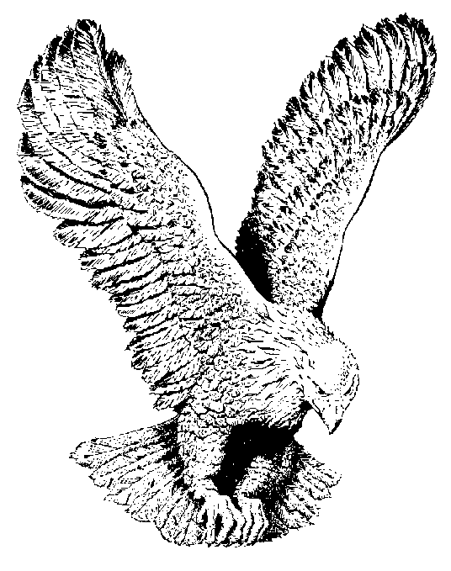
THERE REMAINETH THEREFORE
A REST
There remaineth therefore a rest
To the people of God
There remaineth therefore a rest
To the people of God
He that is entered into His rest
He also has ceased from his own works
There remaineth therefore a rest
To the people of God
There remaineth therefore a rest
To the people of God

